Slide 1


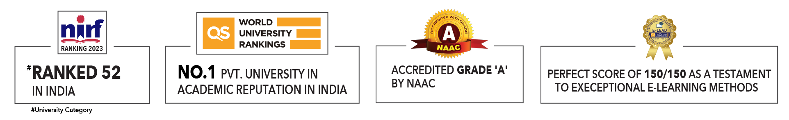
Kidney Stone Detection Using Machine Learning and Deep Learning
Presented by:
R2142220856 – Samaksh Mittal (B2, 500107995)
R2142221184 – Kavya Dangi (B3, 500108583)
Guided by:
Dr Achala Shakya

Slide 2

Contents
Abstract
Introduction
Problem Statement
Motivation
Objectives
Literature Review
Data Analysis
Machine Learning
Logistic Regression
Naïve Bayes
K Nearest Neighbour
Support Vector Machine
Decision Tree
Random Forest

Slide 3
Contents
Deep Learning
Convolution Neural Network
Region Based Convolution Neural Network
MobileNet
VGG19
ResNet50
Evaluation Metrics
All Machine Learning Techniques
All Deep Learning Techniques
All Machine Learning and Deep Learning Techniques
References

Slide 4
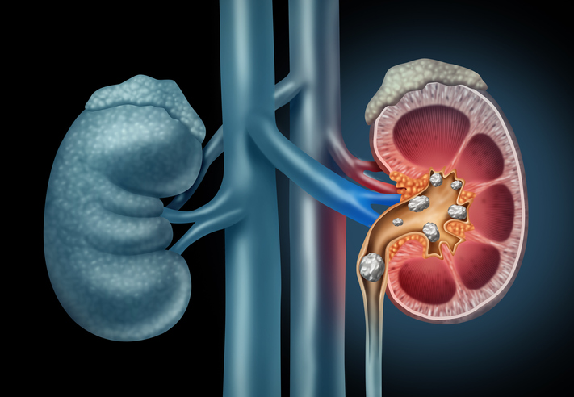
Abstract
This project leverages machine learning to detect kidney stones by classifying medical images into two categories: Normal (no stones) and Stone (presence of stones). Multiple models, including Random Forest, SVM, Logistic Regression, and Decision Tree, were implemented and evaluated. The goal is to identify the most accurate model, enhancing diagnostic accuracy and enabling efficient, automated kidney stone detection to improve patient care.

Slide 5
Introduction
Kidney stones are a common yet painful medical condition, often requiring early detection for effective treatment. Traditional diagnostic methods, while reliable, can be time-consuming and dependent on manual interpretation. This project explores the potential of machine learning in revolutionizing kidney stone detection, utilizing advanced algorithms to classify medical images into Normal and Stone categories. By automating this critical diagnostic process, the project aims to reduce human error, enhance accuracy, and support timely medical interventions. Comparing models like Random Forest, SVM, Logistic Regression, and Decision Tree, this work identifies the most effective approach to build a robust, efficient solution for kidney stone diagnosis.

Slide 6
Problem Statement
Develop an advanced machine learning model to detect kidney stones from medical images, classified into two categories: Normal (no stones) and Stone (presence of stones). This solution aims to enhance diagnostic accuracy, streamline detection processes, and support healthcare professionals in providing timely and effective treatment for kidney stone patients.

Slide 7
Motivation
Prevalence of Kidney Stones: Kidney stones are a growing global health concern, affecting millions of people annually. Timely detection is crucial to avoid complications and provide effective treatment, making early diagnosis a key priority.
Limitations of Traditional Methods: Traditional methods of detecting kidney stones, such as physical examinations, X-rays, and CT scans, are often time-consuming, expensive, and reliant on human expertise. These methods may also involve long waiting times, which can delay critical treatment.
Potential of Machine Learning: Machine learning algorithms can revolutionize kidney stone detection by automating the image classification process. With the ability to process vast amounts of medical images quickly, machine learning models can reduce human error and offer more consistent results.

Slide 8
Objectives
Develop a Robust Classification Model: To create and train machine learning models that can accurately classify medical images of kidneys into two categories: Normal and Stone.
Evaluate Multiple Algorithms: To implement and evaluate the performance of various machine learning algorithms, such as Random Forest, Support Vector Machine (SVM), Logistic Regression, and Decision Tree, in terms of accuracy, precision, and recall.
Optimize Model Performance: To fine-tune the chosen models for optimal performance using techniques like hyperparameter tuning and cross-validation to ensure the highest possible accuracy in kidney stone detection.
Automate the Detection Process: To build an automated system that can process medical images and provide real-time predictions, reducing manual intervention and enhancing diagnostic speed.

Slide 9
Literature Review
S. No. | Authors | Title | Journal/Conference | Year | Key Focus | Major Findings
1 | Saman Ebrahimi, Vladimir Y. Mariano | Image Quality Improvement in Kidney Stone Detection on Computed Tomography | Journal of Image and Graphics | 2015 | Image quality improvement in kidney stone detection on CT images | Enhanced image quality led to better detection accuracy of kidney stones.
2 | Prema T. Akkasaligar, Sunanda Biradar, Veena Kumbar | Kidney Stone Detection in Computed Tomography Images | IEEE | 2017 | Kidney stone detection using CT images | Proposed techniques showed significant improvement in detecting kidney stones from CT scans.
3 | Aniket Gaikwad, Azharuddin Inamdar, Vikas Behera | Lung Cancer Detection Using Digital Image Processing on CT Scan Images | International Research Journal of Engineering and Technology | 2016 | Application of digital image processing for lung cancer detection in CT images | Effective preprocessing and segmentation methods improved detection accuracy for lung cancer.
4 | Brisbane Wayne, R. Bailey Michael, D. Sorensen Mathew | An Overview of Kidney Stone Imaging Techniques | Nature Reviews Urology | 2016 | Comparative analysis of kidney stone imaging methods | Detailed review of various imaging techniques like CT, ultrasound, and MRI for kidney stone diagnosis.
[1]
[2]
[3]
[4]
Table 1 Literature Review

Slide 10
Literature Review
S. No. | Authors | Title | Journal/Conference | Year | Key Focus | Major Findings
5 | S. Asadi, H. Hassanpour, A. Pouyan | Texture-Based Image Enhancement Using Gamma Correction | Middle-East Journal of Scientific Research | 2010 | Enhancing image textures using gamma correction | Improved visibility of medical images using gamma correction for texture-based image enhancement.
6 | R. C. Gonzalez, R. E. Woods | Digital Image Processing | Book | 1992 | Fundamentals of digital image processing | Introduced foundational concepts and algorithms in digital image processing.
7 | D. Y. Kim, J. W. Park | Computer-Aided Detection of Kidney Tumor on Abdominal CT Scans | Acta Radiologica | 2004 | Computer-aided detection of kidney tumors | Achieved improved tumor localization using computer-aided techniques.
8 | D. T. Lin, C. C. Lei, S. W. Hung | Computer-Aided Kidney Segmentation on Abdominal CT Images | IEEE Transactions on Information Technology in Biomedicine | 2006 | Automated kidney segmentation in CT images | Presented a reliable algorithm for segmenting kidneys in CT scans.
9 | F. L. Coe, A. Evan, E. Worcester | Kidney Stone Disease | Journal of Clinical Investigation | 2005 | Overview of kidney stone disease | Explored causes, prevention, and treatments for kidney stones.
[5]
[6]
[7]
[8]
[9]
Table 1 Literature Review

Slide 11
Literature Review
S. No. | Authors | Title | Journal/Conference | Year | Key Focus | Major Findings
10 | F. Grases, A. Costa-Bauza, R. M. Prieto | Renal Lithiasis and Nutrition | Nutrition Journal | 2006 | Role of nutrition in kidney stone formation | Found a significant relationship between dietary factors and kidney stone formation.
11 | Sri Madhava Raja N, Rajinikanth V, Latha K | Otsu-Based Optimal Multilevel Image Thresholding Using Firefly Algorithm | Modelling and Simulation in Engineering | 2014 | Image thresholding for segmentation | Proposed a firefly algorithm-based method for efficient image thresholding.
12 | R. Vishnupriya, N. Sri Madhava Raja, V. Rajinikanth | An Efficient Clustering Technique and Analysis of Infrared Thermograms | International Conference on Biosignals Images and Instrumentation | 2017 | Clustering analysis of infrared thermograms | Developed an efficient clustering method for thermal imaging analysis.
13 | N. Sri Madhava Raja, S. L. Fernandes, Nilanjan Dev, S. Chandra Satapathy, V. Rajinikanth | Contrast-Enhanced Medical MRI Evaluation Using Tsallis Entropy and Region Growing Segmentation | Journal of Ambient Intelligence and Humanized Computing | 2018 | MRI image evaluation using contrast enhancement | Applied Tsallis entropy for better segmentation and evaluation of medical MRI images.
14 | N. S. M. Raja, P. R. V. Lakshmi, K. P. Gunasekaran | Firefly Algorithm-Assisted Segmentation of Brain Regions Using Tsallis Entropy and Markov Random Field | Lecture Notes in Networks and Systems | 2018 | Brain region segmentation using firefly algorithm | Improved brain region segmentation in MRI images using entropy and Markov Random Field models.
[10]
[11]
[12]
[13]
[14]
Table 1 Literature Review

Slide 12
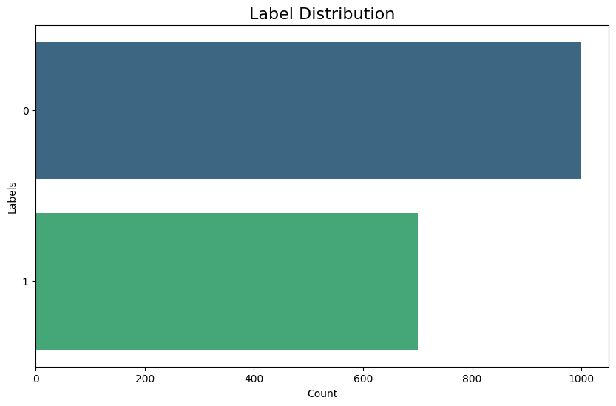
Data Analysis – Labels Distribution
1
Fig. 1 shows the distribution of each label as per their image count.
2
Label 0 represents there is no kidney stone present.
3
Label 1 represents there is kidney stone present.
4
Label 0: 1000 images
Label 1: 700 images
Fig. 1 Label Distribution

Slide 13
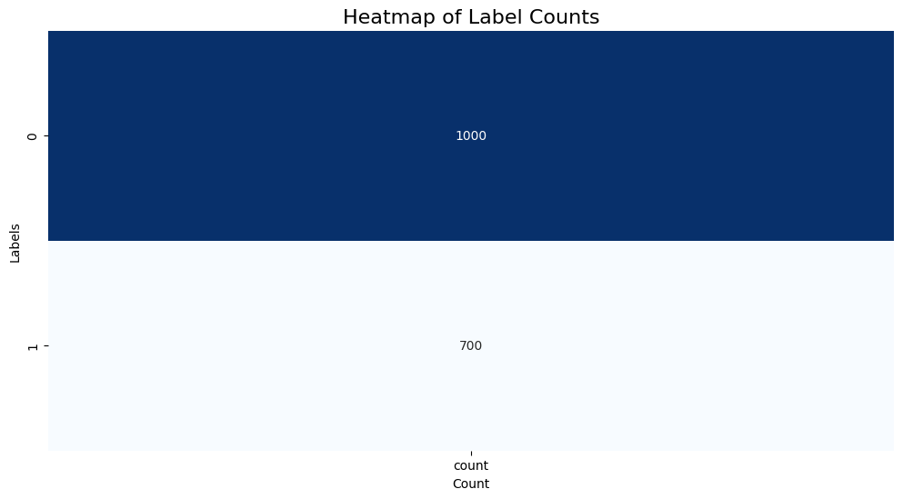
Data Analysis – Heatmap of Label Count
Fig. 2 Heatmap of Label Count

Slide 14
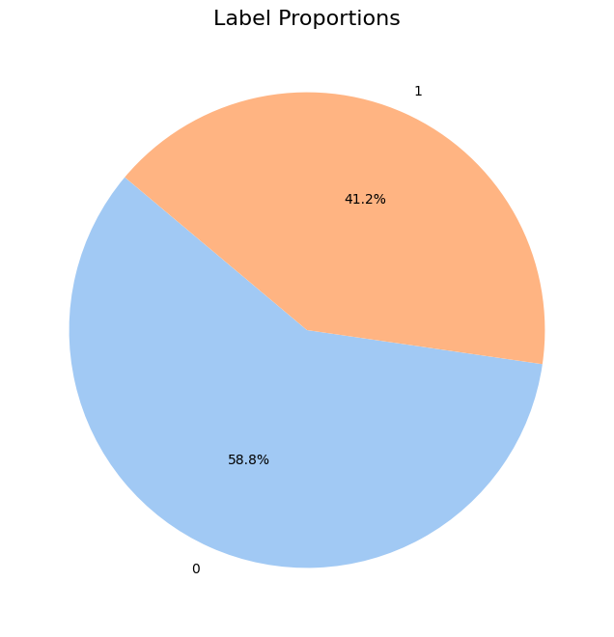
Data Analysis – Label Proportions
1
Fig. 3 shows the proportions of each label as per their image count.
2
Label 0 represents there is no kidney stone present.
3
Label 1 represents there is kidney stone present.
4
Label 0: 58.8%
Label 1: 41.2%
Fig. 3 Label Proportions

Slide 15
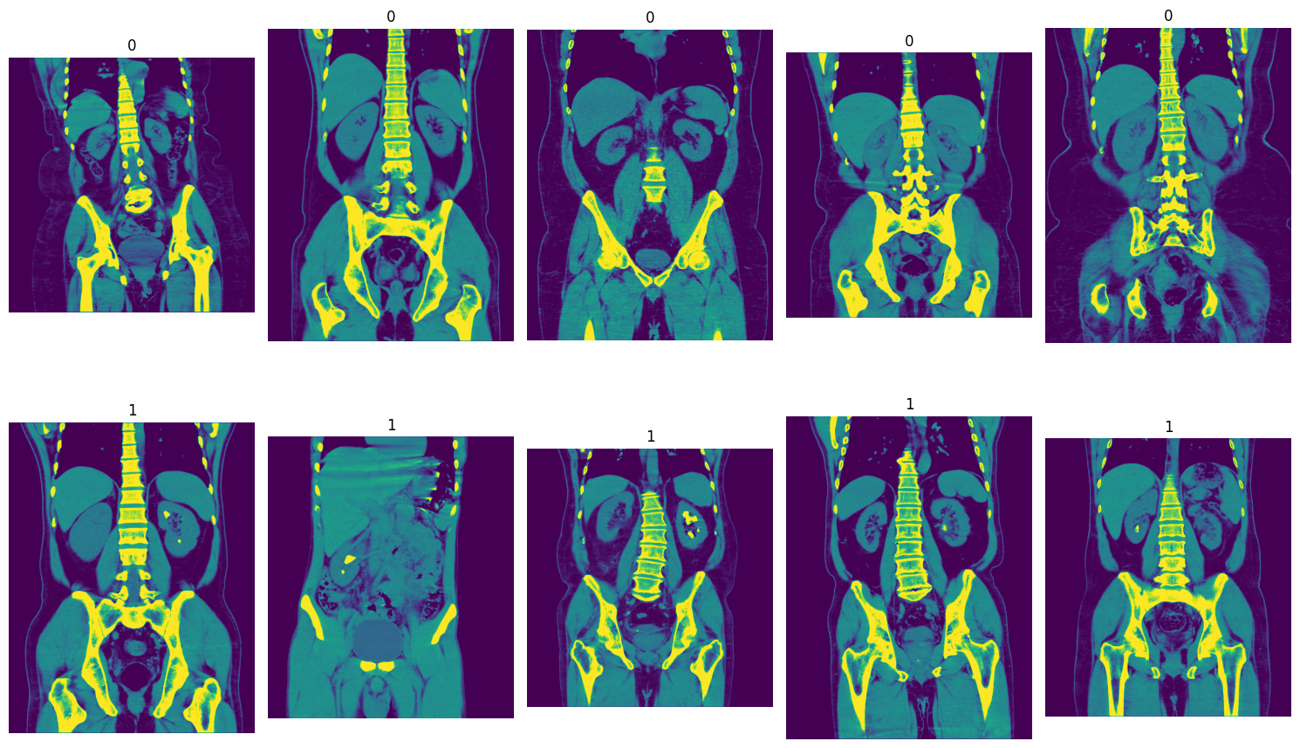
Data Analysis – Example Images
Fig. 4 Example Images

Slide 16

Machine Learning
Data-Driven Decision Making: Machine learning models help in analyzing large datasets to identify patterns and make informed predictions.
Automation of Complex Tasks: These models automate tasks that traditionally require human intervention, improving efficiency and accuracy.
Improved Accuracy: Machine learning models continually learn from data, leading to improved prediction accuracy over time.
Versatility in Applications: From image recognition to medical diagnoses, machine learning models can be applied across a wide range of industries and domains.

Slide 17
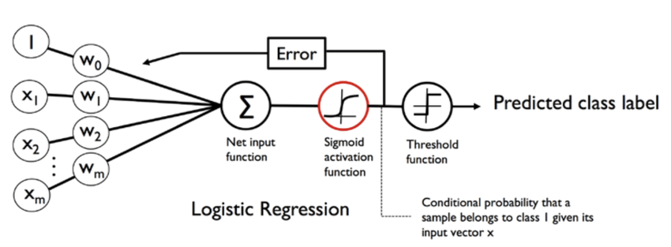
Logistic Regression
Fig. 5 Logistic Regression Architecture
[15]
1
Binary Classification: Logistic regression is commonly used for binary classification tasks, predicting outcomes like "yes/no" or "true/false".
2
Probability Estimation: It estimates the probability of a given input belonging to a certain class, providing a score between 0 and 1.

Slide 18
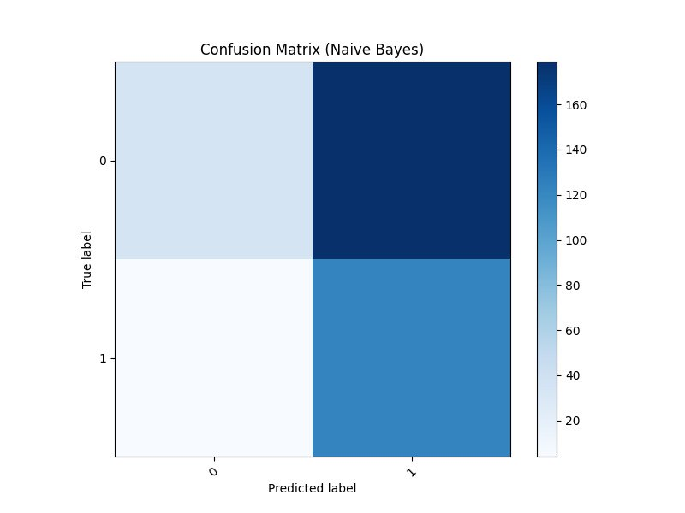
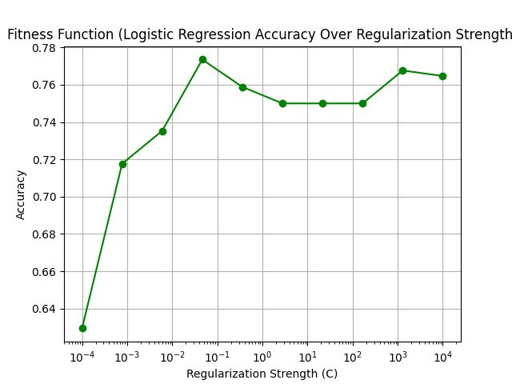
Logistic Regression
Fig. 6 Confusion Matrix for Naïve Bayes
Fig. 7 Fitness Function for Logistic Regression

Slide 19
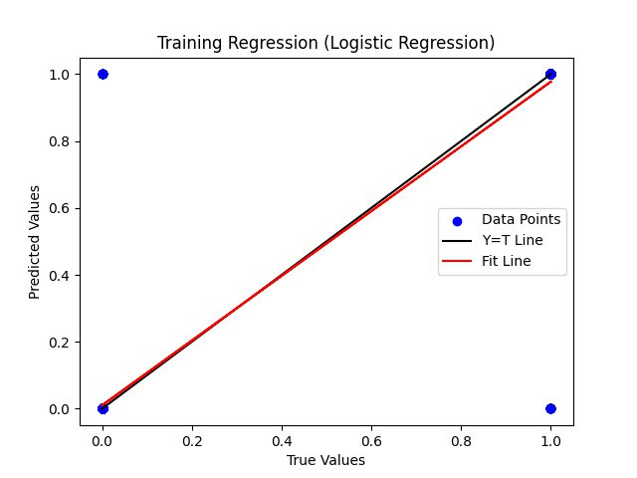
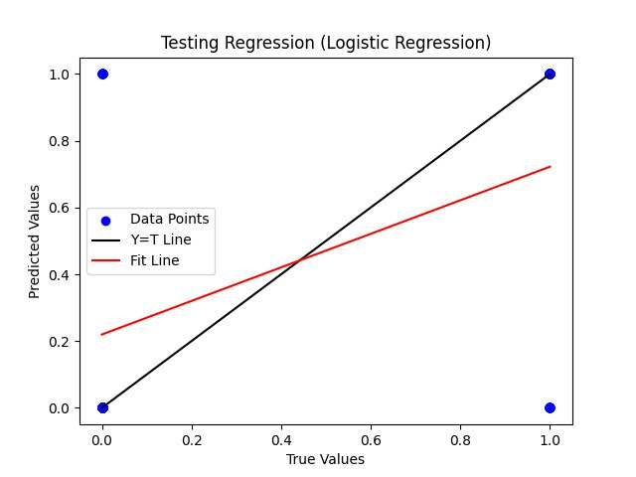
Logistic Regression
Fig. 8 Training Regression for Logistic Regression
Fig. 9 Testing Regression for Logistic Regression

Slide 20
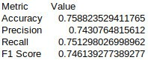
Logistic Regression: Evaluation Metrics
Fig. 10 Evaluation Metrics for Logistic Regression

Slide 21
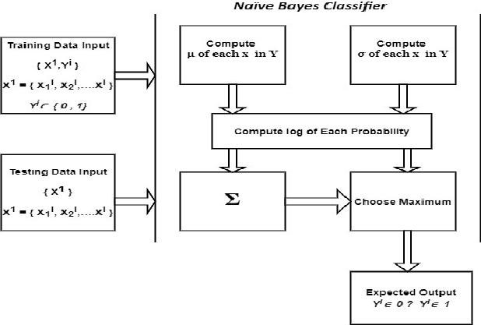
Naïve Bayes
1
Probabilistic: Uses Bayes' theorem for classification.
2
Independence Assumption: Assumes feature independence.
3
Efficient: Fast and scalable for large datasets.
4
Common Applications: Used in text classification and medical predictions.
Fig. 11 Naïve Bayes Architecture
[16]

Slide 22
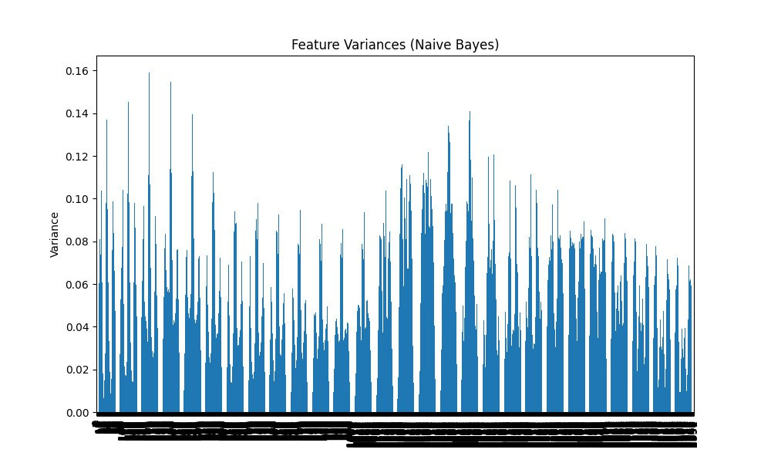
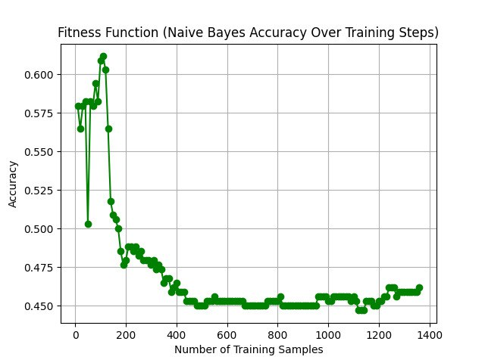
Naïve Bayes
Fig. 12 Feature Variances for Naïve Bayes
Fig. 13 Fitness Function for Naïve Bayes

Slide 23
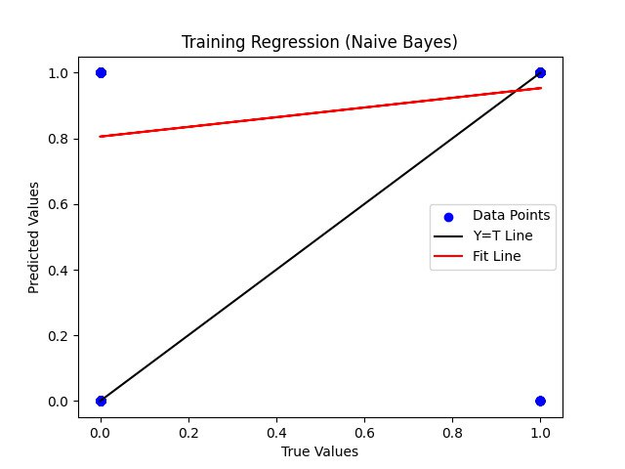

Naïve Bayes
Fig. 14 Training Regression for Naïve Bayes
Fig. 15 Testing Regression for Naïve Bayes

Slide 24
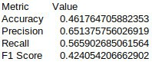
Naïve Bayes: Evaluation Metrics
Fig. 16 Evaluation Metrics for Naïve Bayes

Slide 25
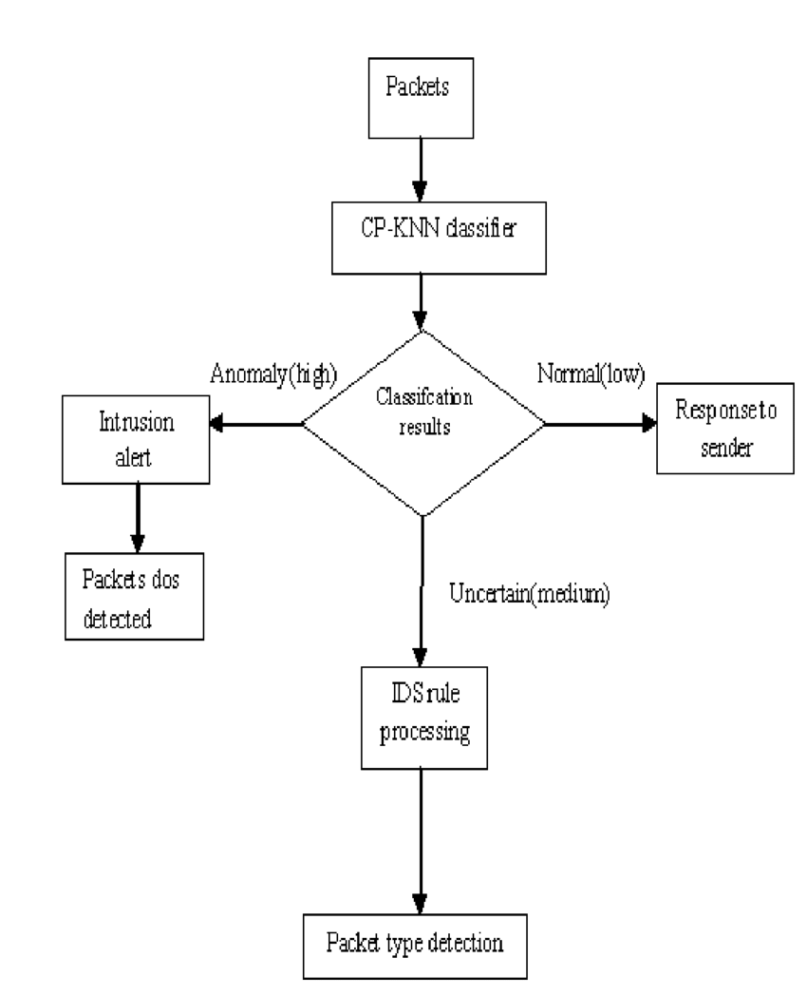
K Nearest Neighbor
1
Instance-based: Classifies based on nearest data points.
2
Non-parametric: No assumptions about data distribution.
3
Simple: Easy to understand and implement.
4
Flexible: Works for both classification and regression tasks.
Fig. 17 KNN Architecture
[17]

Slide 26
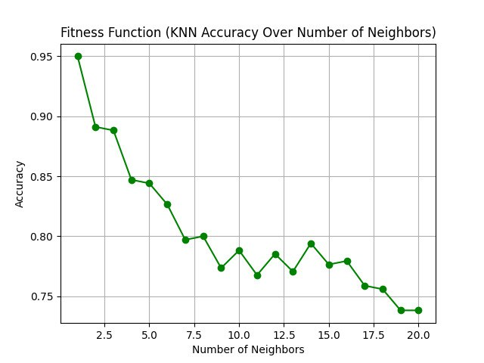
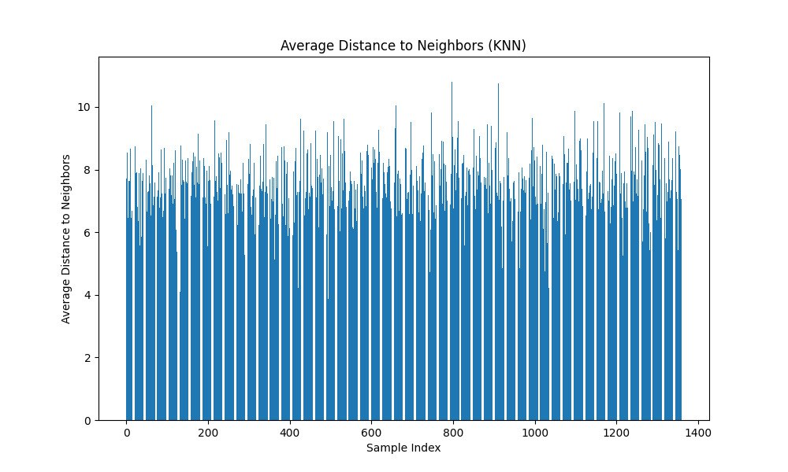
K Nearest Neighbor
Fig. 18 Average Distance to Neighbors for KNN
Fig. 19 Fitness Function for KNN

Slide 27
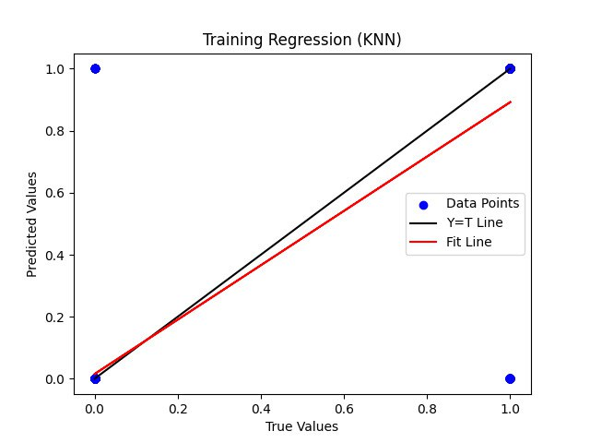
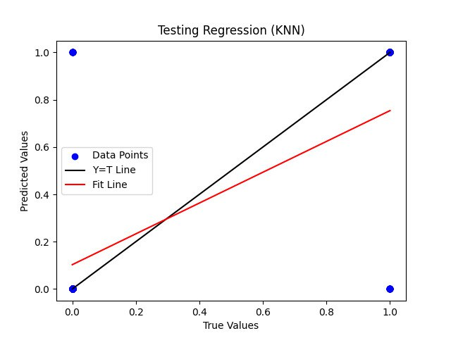
K Nearest Neighbor
Fig. 20 Training Regression for KNN
Fig. 21 Testing Regression for KNN

Slide 28
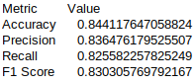
K Nearest Neighbor: Evaluation Metrics
Fig. 22 Evaluation Metrics for KNN

Slide 29
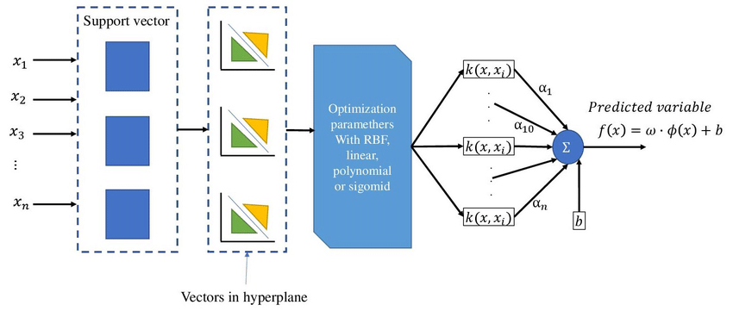
Support Vector Machine
Fig. 23 SVM Architecture
[18]
1
Margin Maximization: SVM finds the optimal hyperplane that maximizes the margin between classes.
2
Effective for High Dimensions: Works well in high-dimensional spaces.

Slide 30
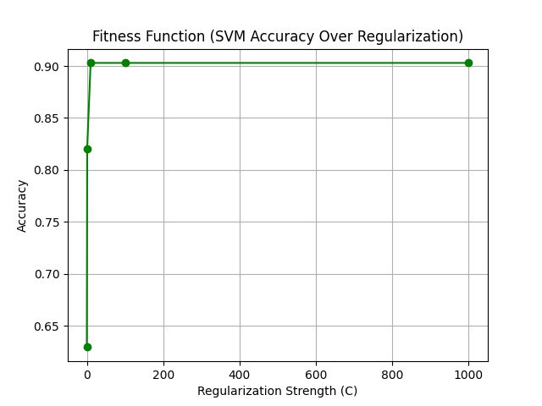
Support Vector Machine
Fig. 24 Fitness Function for SVM

Slide 31

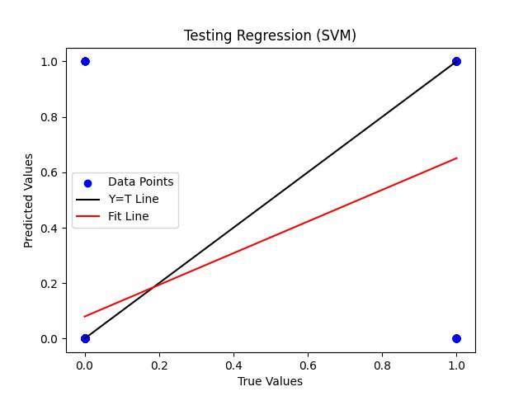
Support Vector Machine
Fig. 25 Training Regression for SVM
Fig. 26 Testing Regression for SVM

Slide 32
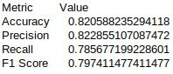
Support Vector Machine: Evaluation Metrics
Fig. 27 Evaluation Metrics for SVM

Slide 33
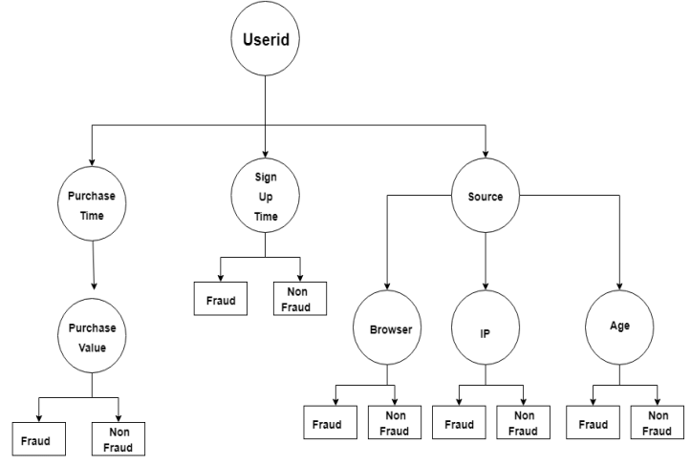
Decision Tree
1
Tree Structure: Splits data based on feature values.
2
Interpretable: Easy to understand and visualize.
3
Handles Both Data Types: Works with numerical and categorical data.
4
Overfitting Risk: Prone to overfitting, but can be controlled.
Fig. 28 DT Architecture
[19]

Slide 34
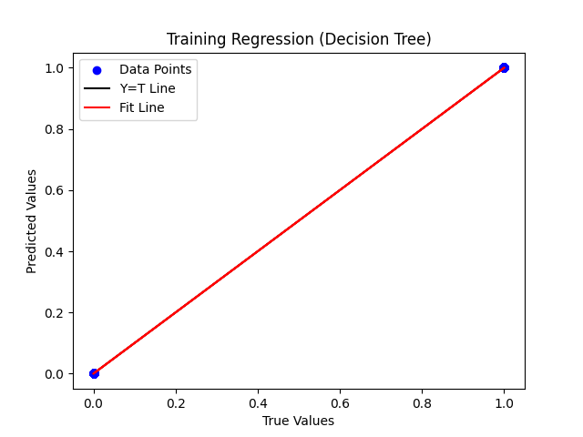
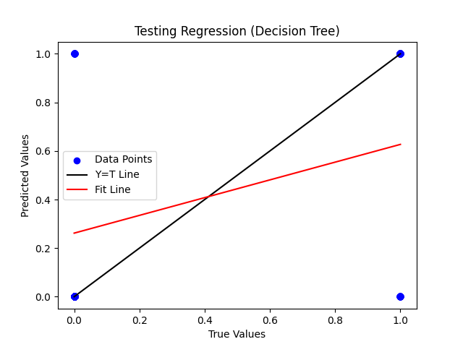
Decision Tree
Fig. 29 Training Regression for DT
Fig. 30 Testing Regression for DT

Slide 35
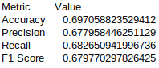
Decision Tree: Evaluation Metrics
Fig. 31 Evaluation Metrics for DT

Slide 36
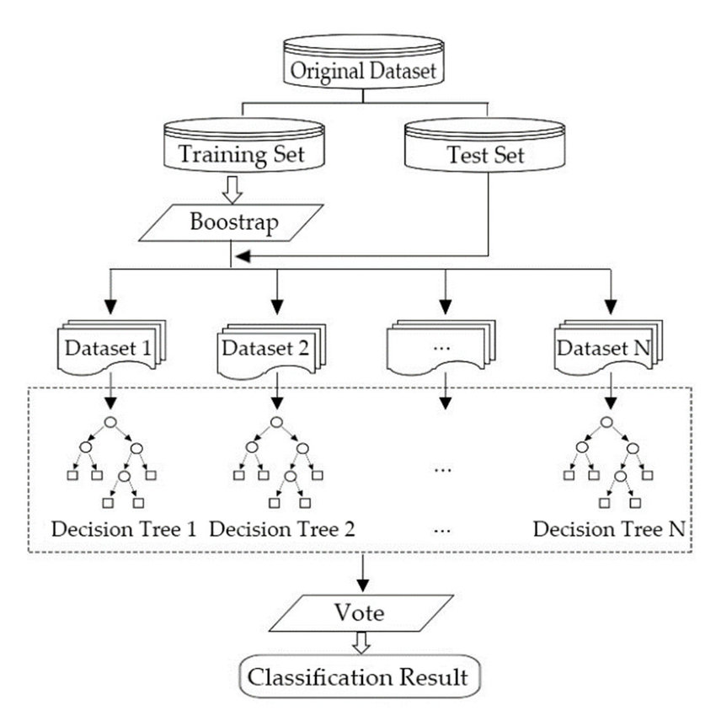
Random Forest
1
Combines multiple decision trees for better accuracy.
2
Versatile: Handles both classification and regression tasks.
3
Robust: Reduces overfitting compared to single trees.
4
Feature Importance: Highlights key features influencing predictions.
Fig. 32 Random Forest Architecture
[20]

Slide 37
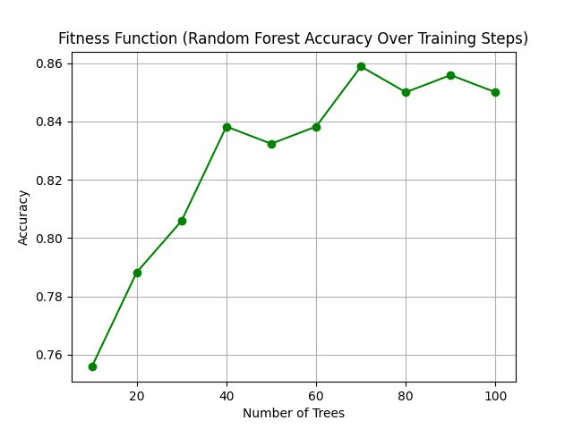
Random Forest
Fig. 33 Fitness Function for Random Forest

Slide 38
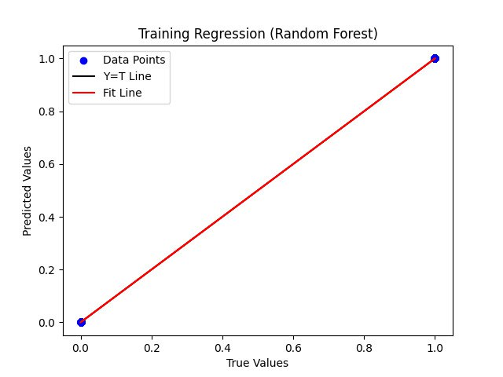
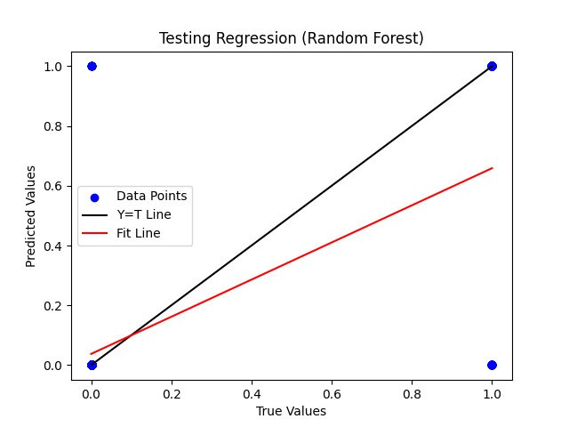
Random Forest
Fig. 34 Training Regression for Random Forest
Fig. 35 Testing Regression for Random Forest

Slide 39
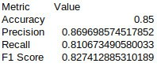
Random Forest: Evaluation Metrics
Fig. 36 Evaluation Metrics for Random Forest

Slide 40
Deep Learning
Neural Networks: Deep learning uses artificial neural networks with multiple layers to mimic the way the human brain processes information.
High Accuracy: It achieves state-of-the-art accuracy in tasks such as image recognition, natural language processing, and speech recognition due to its ability to learn hierarchical features.
Data-Driven: Deep learning models thrive on large datasets, as they use vast amounts of data to improve their performance and generalization.
Wide Applications: Deep learning powers cutting-edge advancements in different fields

Slide 41

Convolution Neural Network
Fig. 37 CNN Architecture
[21]
1
Image Processing: CNNs specialize in analyzing image data by recognizing patterns like edges and textures.
2
Feature Extraction: They use convolution layers to automatically learn features, reducing manual effort.

Slide 42
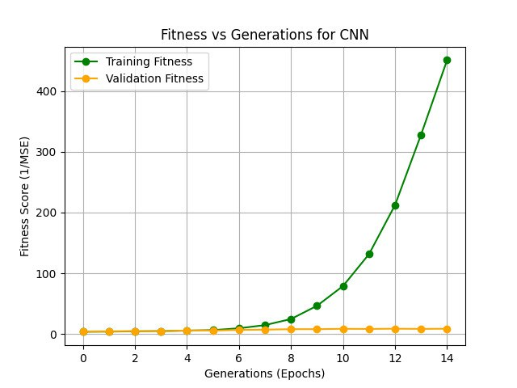
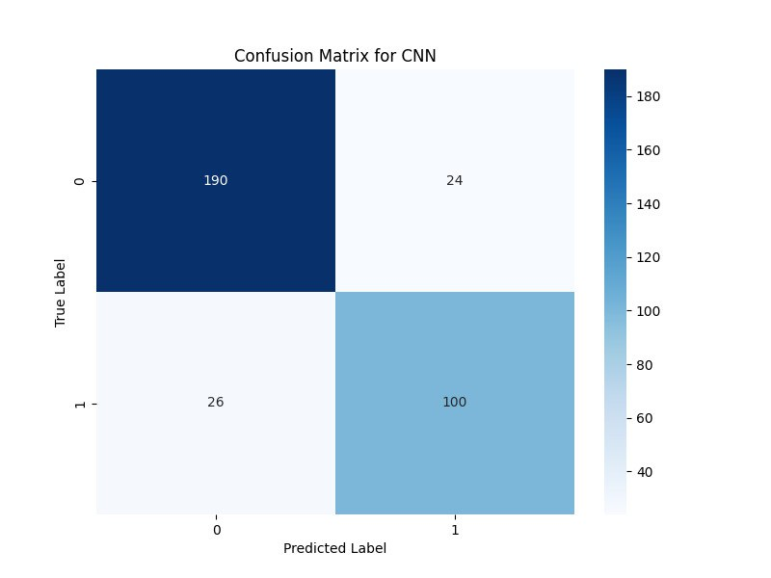
Convolution Neural Network
Fig. 38 Confusion Matrix for CNN
Fig. 39 Fitness vs Generations for CNN

Slide 43
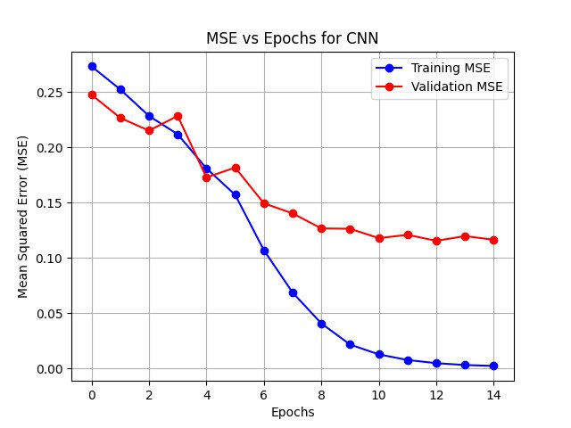
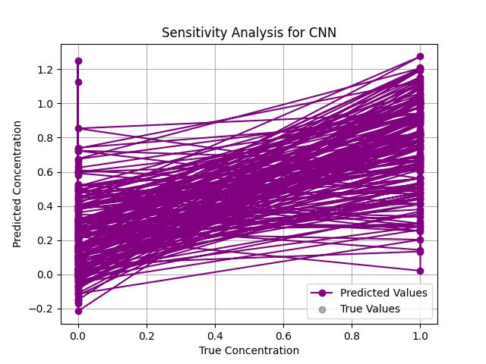
Convolution Neural Network
Fig. 40 MSE vs Epochs for CNN
Fig. 41 Sensitivity Analysis for CNN

Slide 44
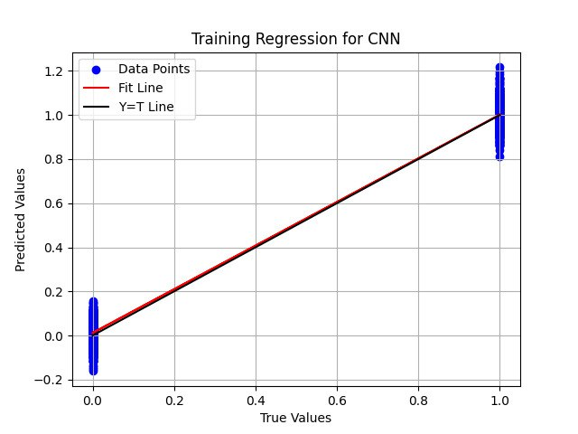
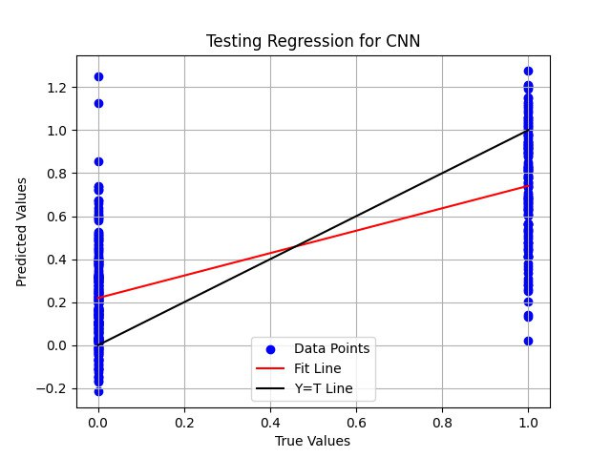
Convolution Neural Network
Fig. 42 Training Regression for CNN
Fig. 43 Testing Regression for CNN

Slide 45
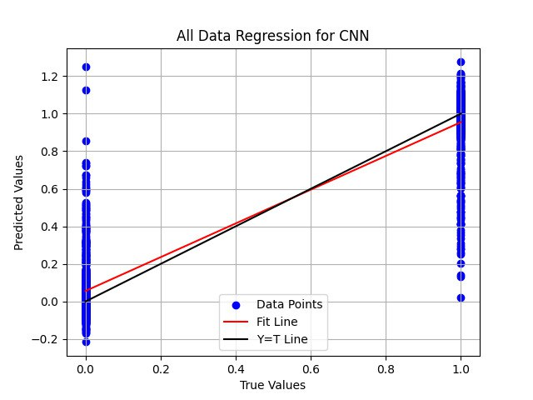
Convolution Neural Network
Fig. 44 All Data Regression for CNN

Slide 46
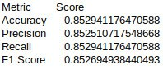
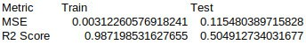
Convolution Neural Network: Evaluation Metrics
Fig. 45 Evaluation Metrics for CNN
Fig. 46 Model Metrics for CNN

Slide 47
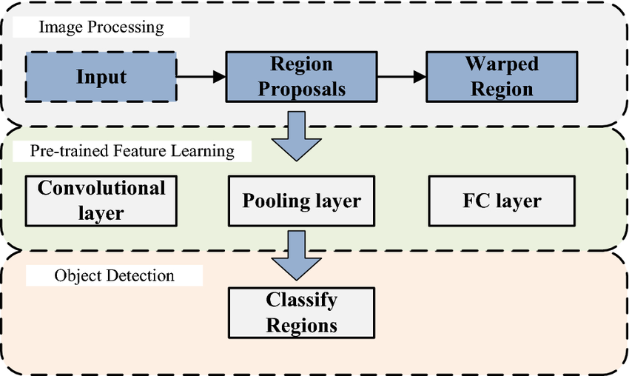
Region Based CNN
1
Object Detection: RCNN is designed for detecting objects in images.
2
Region Proposals: It generates region proposals before classification.
3
Accurate: Improves accuracy compared to traditional methods.
4
Requires more computation due to its multi-stage process.
Fig. 47 RCNN Architecture
[22]

Slide 48
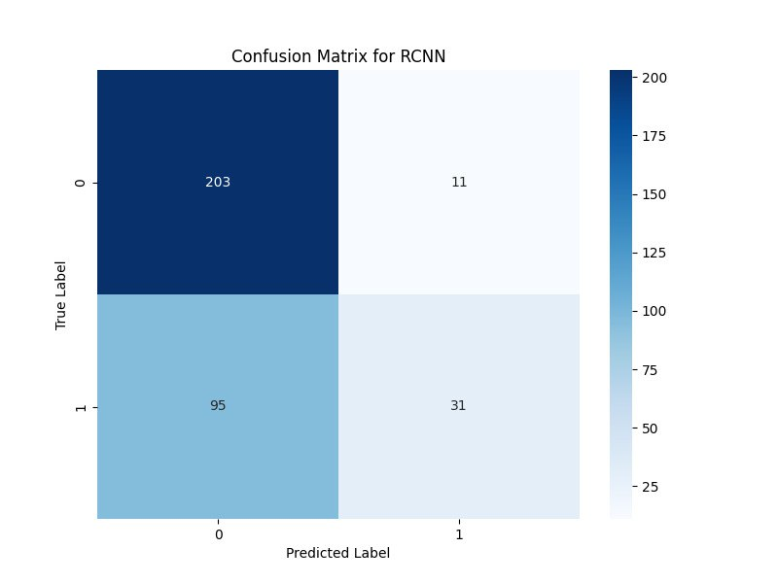
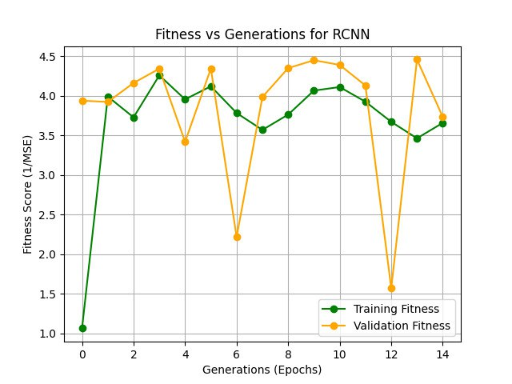
Region Based CNN
Fig. 48 Confusion Matrix for RCNN
Fig. 49 Fitness vs Generations for RCNN

Slide 49
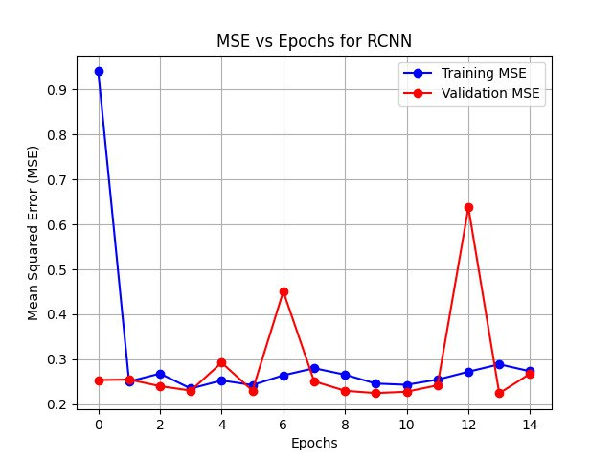
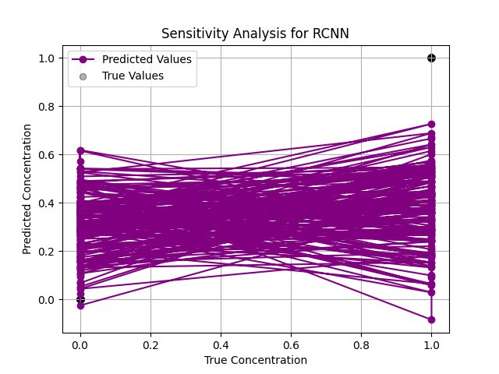
Region Based CNN
Fig. 50 MSE vs Epochs for RCNN
Fig. 51 Sensitivity Analysis for RCNN

Slide 50


Region Based CNN
Fig. 52 Training Regression for RCNN
Fig. 53 Testing Regression for RCNN

Slide 51

Region Based CNN
Fig. 54 All Data Regression for RCNN

Slide 52


Region Based CNN: Evaluation Metrics
Fig. 55 Evaluation Metrics for RCNN
Fig. 56 Model Metrics for RCNN

Slide 53

MobileNet
Fig. 57 MobileNet Architecture
[23]
1
Lightweight: MobileNet is designed for mobile and embedded devices with limited resources.
2
Real-time Performance: Optimized for fast processing and real-time applications as used in kidney stone detection.

Slide 54


MobileNet
Fig. 58 Confusion Matrix for MobileNet
Fig. 59 Fitness vs Generations for MobileNet

Slide 55


MobileNet
Fig. 60 MSE vs Epochs for MobileNet
Fig. 61 Sensitivity Analysis for MobileNet

Slide 56


MobileNet
Fig. 62 Training Regression for MobileNet
Fig. 63 Testing Regression for MobileNet

Slide 57

MobileNet
Fig. 64 All Data Regression for MobileNet

Slide 58


MobileNet: Evaluation Metrics
Fig. 65 Evaluation Metrics for MobileNet
Fig. 66 Model Metrics for MobileNet

Slide 59

VGG19
Fig. 67 VGG19 Architecture
[24]
1
Deep Architecture: VGG19 has 19 layers, offering a deep network for complex feature extraction.
2
Simple Design: Uses 3x3 convolution filters and 2x2 max-pooling layers, ensuring simplicity and efficiency.

Slide 60


VGG19
Fig. 68 Confusion Matrix for VGG19
Fig. 69 Fitness vs Generations for VGG19

Slide 61


VGG19
Fig. 70 MSE vs Epochs for VGG19
Fig. 71 Sensitivity Analysis for VGG19

Slide 62


VGG19
Fig. 72 Training Regression for VGG19
Fig. 73 Testing Regression for VGG19

Slide 63

VGG19
Fig. 74 All Data Regression for VGG19

Slide 64


VGG19: Evaluation Metrics
Fig. 75 Evaluation Metrics for VGG19
Fig. 76 Model Metrics for VGG19

Slide 65

ResNet50
Fig. 77 ResNet50 Architecture
[25]
1
Residual Connections: ResNet uses skip connections (residuals) to bypass layers, solving vanishing gradient issues.
2
Strong Performance: ResNet achieves state-of-the-art results in image classification and object detection tasks.

Slide 66


ResNet50
Fig. 78 Confusion Matrix for ResNet50
Fig. 79 Fitness vs Generations for ResNet50

Slide 67


ResNet50
Fig. 80 MSE vs Epochs for ResNet50
Fig. 81 Sensitivity Analysis for ResNet50

Slide 68


ResNet50
Fig. 82 Training Regression for ResNet50
Fig. 83 Testing Regression for ResNet50

Slide 69

ResNet50
Fig. 84 All Data Regression for ResNet

Slide 70


ResNet50: Evaluation Metrics
Fig. 85 Evaluation Metrics for ResNet50
Fig. 86 Model Metrics for ResNet50

Slide 71

All ML Models: Evaluation Metrics
Fig. 87 Evaluation Metrics for all ML models

Slide 72

All DL Models: Evaluation Metrics
Fig. 88 Evaluation Metrics for all DL models

Slide 73

All Models: Evaluation Metrics
Fig. 89 Evaluation Metrics for all models

Slide 74
References
Ebrahimi, S., & Mariano, V. Y. (2015). Image quality improvement in kidney stone detection on computed tomography. Journal of Image and Graphics, 3(1), June.
Akkasaligar, P. T., Biradar, S., & Kumbar, V. (2017). Kidney stone detection in computed tomography images. In IEEE Proceedings.
Gaikwad, A., Inamdar, A., & Behera, V. (2016). Lung cancer detection using digital image processing on CT scan images. International Research Journal of Engineering and Technology.
Wayne, B., Bailey, M. R., & Sorensen, M. D. (2016). An overview of kidney stone imaging techniques. Nature Reviews Urology, 13(11).
Asadi, S., Hassanpour, H., & Pouyan, A. (2010). Texture-based image enhancement using gamma correction. Middle-East Journal of Scientific Research, 6(6), 569–574.
Gonzalez, R. C., & Woods, R. E. (1992). Digital Image Processing (2nd ed., pp. 47–51).
Kim, D. Y., & Park, J. W. (2004). Computer-aided detection of kidney tumor on abdominal computed tomography scans. Acta Radiologica, 45(7), 791–795.
Lin, D. T., Lei, C. C., & Hung, S. W. (2006). Computer-aided kidney segmentation on abdominal CT images. IEEE Transactions on Information Technology in Biomedicine, 10(1), 59–65. https://doi.org/10.1109/TITB.2006.862739

Slide 75
References
Coe, F. L., Evan, A., & Worcester, E. (2005). Kidney stone disease. Journal of Clinical Investigation, 115(10), 2598–2608. https://doi.org/10.1172/JCI26662
Grases, F., Costa-Bauza, A., & Prieto, R. M. (2006). Renal lithiasis and nutrition. Nutrition Journal, 5(23), 1–7. https://doi.org/10.1186/1475-2891-5-23
Madhava, S., Raja, N., Rajinikanth, V., & Latha, K. (2014). Otsu-based optimal multilevel image thresholding using firefly algorithm. Modelling and Simulation in Engineering. https://doi.org/10.1155/2014/617498
Vishnupriya, R., Madhava Raja, N. S., & Rajinikanth, V. (2017). An efficient clustering technique and analysis of infrared thermograms. In Proceedings of the 2017 Third International Conference on Biosignals, Images, and Instrumentation (ICBSII) (pp. 1–5). IEEE. https://doi.org/10.1109/ICBSII.2017.8082245
Madhava Raja, N. S., Fernandes, S. L., Dev, N., Satapathy, S. C., & Rajinikanth, V. (2018). Contrast-enhanced medical MRI evaluation using Tsallis entropy and region growing segmentation. Journal of Ambient Intelligence and Humanized Computing. https://doi.org/10.1007/s12652-018-0740-4
Madhava Raja, N. S., Lakshmi, P. R. V., & Gunasekaran, K. P. (2018). Firefly algorithm-assisted segmentation of brain regions using Tsallis entropy and Markov random field. In Innovations in Electronics and Communication Engineering (Vol. 7, pp. 235–244). Singapore: Springer. https://doi.org/10.1007/978-981-10-5569-3_21

Slide 76
References
Author(s). (n.d.). A machine-learning approach to distinguish passengers and drivers reading while driving [Scientific figure]. Retrieved from https://www.researchgate.net/figure/Architecture-of-a-Logistic-Regression-Model-56_fig7_334575492
Author(s). (n.d.). A study of stock market prediction through sentiment analysis [Scientific figure]. Retrieved November 20, 2024, from https://www.researchgate.net/figure/Architecture-of-Naive-Bayes-Classifier_fig1_368646502
Author(s). (n.d.). A novel intrusion detection model for mobile ad-hoc networks using CP-KNN [Scientific figure]. Retrieved November 20, 2024, from https://www.researchgate.net/figure/Design-Architecture-of-CP-KNN_fig1_307675744
Author(s). (n.d.). Hybrid techniques to predict solar radiation using support vector machine and search optimization algorithms: A review [Scientific figure]. Retrieved November 20, 2024, from https://www.researchgate.net/figure/General-architecture-of-a-support-vector-maching-SVM-model-according-to-55_fig3_348745187
Author(s). (n.d.). Fraud detection using machine learning in e-commerce [Scientific figure]. Retrieved November 20, 2024, from https://www.researchgate.net/figure/Architecture-of-Decision-Trees_fig3_336148901

Slide 77
References
Author(s). (n.d.). Pre-evacuation time estimation-based emergency evacuation simulation in urban residential communities [Scientific figure]. Retrieved November 21, 2024, from https://www.researchgate.net/figure/Architecture-of-the-Random-Forest-algorithm_fig1_337407116
Author(s). (n.d.). A high-accuracy model average ensemble of convolutional neural networks for classification of cloud image patches on small datasets [Scientific figure]. Retrieved November 21, 2024, from https://www.researchgate.net/figure/Schematic-diagram-of-a-basic-convolutional-neural-network-CNN-architecture-26_fig1_336805909
Author(s). (n.d.). A maximum-entropy-attention-based convolutional neural network for image perception [Scientific figure]. Retrieved November 21, 2024, from https://www.researchgate.net/figure/Architecture-of-the-R-CNN-model_fig1_362218031
Author(s). (n.d.). Efficient approach towards detection and identification of copy move and image splicing forgeries using Mask R-CNN with MobileNet V1 [Scientific figure]. Retrieved November 21, 2024, from https://www.researchgate.net/figure/The-architecture-of-MobileNet-V1-30_fig5_357623745
Author(s). (n.d.). Generalization of convolutional network to domain adaptation network for classification of disaster images on Twitter [Scientific figure]. Retrieved November 21, 2024, from https://www.researchgate.net/figure/VGG-19-Architecture-39-VGG-19-has-16-convolution-layers-grouped-into-5-blocks-After_fig5_359771670

Slide 78
References
Author(s). (n.d.). Performance evaluation of deep CNN-based crack detection and localization techniques for concrete structures [Scientific figure]. Retrieved November 21, 2024, from https://www.researchgate.net/figure/The-architecture-of-ResNet-50-model_fig4_349717475

